Slide 1
Quant Strategy Project
Alex Ng, Asher Choi

Slide 2
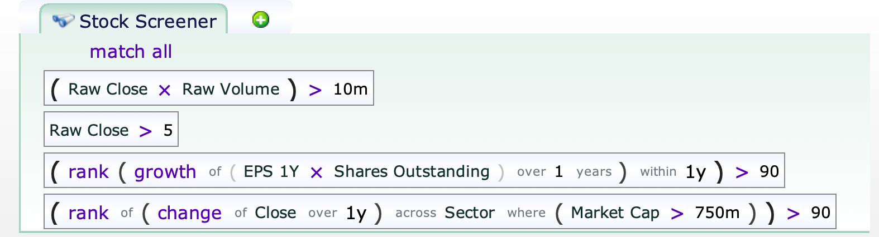
Quant Strategy & Rationale (Long)
Top 10th percentile of growth of earnings in the past 1 year as of the rebalancing period (momentum)
Top 10th percentile of change in closing price across sectors over the past 1 year among large cap stocks.
Notes:
The long position will utilize growth and momentum strategies. Given the consistent growth of the stock market, a growth strategy will find companies with improving financial performance. The strategy will invest in stocks whose earnings are consistently and robustly increasing over the past 1 year. This will avoid stocks where growth potential is ultimately unrealized but was initially fully factored in their stock price. The long position will also invest in stocks whose change of closing price over the last 1 year is at the top 10th percentile to pursue high returns. This ranking is based on the industry of the stocks to avoid a selection bias where we only heavily invest in technology and consumer discretionary industries. In this screener, we only take large cap stocks into account. This mainly serves to reduce excessive risks and avoid comparing against nonpersistent price growth from small and micro cap stocks.

Slide 3
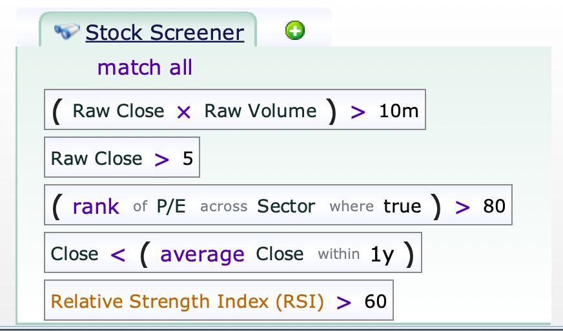
Quant Strategy & Rationale (Short)
Top 20th percentile of P/E
Closed below their 1-year moving average
Filter overbought stocks showing an RSI greater than 60
Rationale: Find stocks that performed well in the past, but were potentially overextended in price. Short the ones with weakness and confirmation.

Slide 4
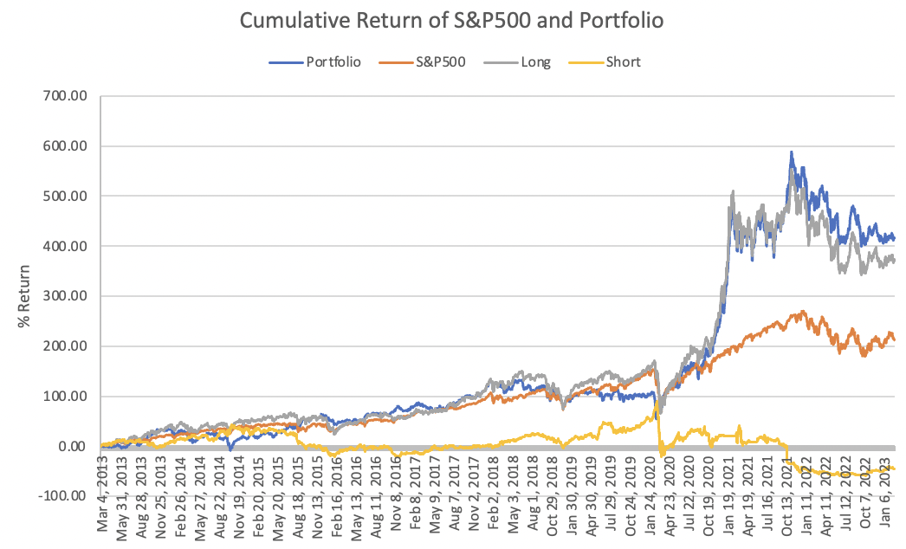
Back Test Statistics
Annual Return: 15.43%
Annual SD: 28.93%
Sharpe Ratio: 0.65
Beta: -0.07

Slide 5
Discussions
Near zero beta with an alpha of 19.87%
Achieves market neutrality
Is generating excess returns while reducing systematic risk exposure
Portfolio spike in post COVID bull market
Momentum and reversal strategies were highly profitable during this time
2021 bull run was largely caused by new entrants into the markets in the form of retail investors
High volatility environment
Relatively low Calmar ratio
Maximum drawdown of 46.17%
Annualized growth of 15.43%
Although portfolio made a full recovery, this can imply maximum drawdown risk was larger than annualized growth at times when the portfolio underperformed

